Slide 1
Romanian PowerShell User Group
5th Meeting – February 28th 2017

Slide 2
Network Mapping with PowerShell
Neacsu Costin-Alin

Slide 3
PS C:\> $env:USERNAME
-not Sysadmin
-not Developer
PS C:\> $env:POSITION
Vulnerability Assessment Engineer at NTT Data Services, formerly Dell Services
PS C:\> $env:CONTACT
Twitter: @z00v4sh
LinkedIn: https://www.linkedin.com/in/caneacsu/
Email: caneacsu@gmail.com

Slide 4
Scenario: Attacker gains access to a station inside the network.
Question: How to discover additional hosts and services on the local network ?

Slide 5

Native to Windows environments
Built on top of .NET Framework
Rich set of Cmdlets
Full access to WMI
Powerful scripting engine
Much more ...

Slide 6
PowerShell Version | Installed by default on | Can be Installed on
PowerShell 1.0 | - | Windows XP SP2 Windows Server 2003 Windows Vista Windows Server 2008
PowerShell 2.0 | Windows 7 Windows Server 2008 R2 | Windows XP SP3 Windows Server 2003 SP2 Windows Vista SP1
PowerShell 3.0 | Windows 8 Windows Server 2012 | Windows 7 SP1 Windows Server 2008 SP2 Windows Server 2008 R2 SP1
PowerShell 4.0 | Windows 8.1 Windows Server 2012 R2 | Windows 7 SP1 Windows Server 2008 R2 SP1 Windows Server 2012
PowerShell 5.0 | Windows 10 Windows Server 2016 | Windows 7 SP1 Windows 8.1 Windows Server 2008 R2 SP1 Windows Server 2012 Windows Server 2012 R2

Slide 7
Local IP(s)
Ping Sweep
Port Scanner
Active Connections
Reverse DNS
ARP Scanner
Places to look

Slide 8
Cmdlets
.NET Classes
WMI
Win32 API
Methods Used

Slide 9
PREREQUISITES

Slide 10
ARP (Address Resolution Protocol)
Queries IP Addresses for MAC Addresses
We use ARP Request
Opcode 1
Destination MAC: FF-FF-FF-FF-FF-FF
Ethernet Broadcast Address

Slide 11
Ping
Network Diagnostic Tool
Uses ICMP (Internet Control Message Protocol)
Sends ICMP Echo Request Messages
Type 8
Expects ICMP Echo Reply Messages
Type 0

Slide 12
IP (Internet Protocol)
Main communications protocol in the Internet Protocol Suite
Uses either TCP or UDP
TCP (Transmission Control Protocol)
Connection-oriented (3-Way Handshake)
Reliable
Error-checks
Potentially adds latency
Uses port numbers to distinguish between requests (0-65535)
UDP (User Datagram Protocol)
Connectionless
Fast
Error prone
Also uses port numbers (0-65535)

Slide 13
DNS (Domain Name System)
Hierarchical decentralized naming system
Commonly used to resolve hostnames to IP Addresses
Stores information as records in a database
Multiple types of records:
A record : points a hostname to an IPv4 Address
PTR record: points an IP Address to a hostname
Also known as Reverse DNS

Slide 14
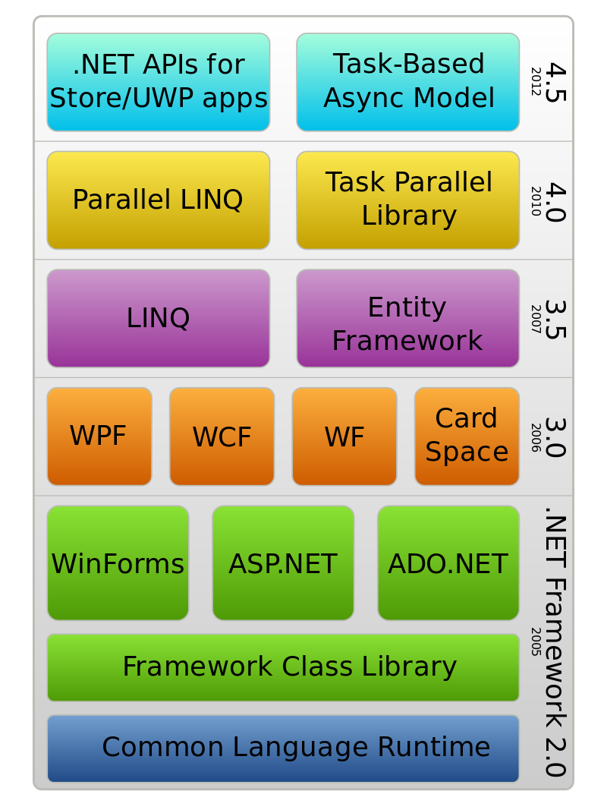
.NET Framework
Software Framework developed by Microsoft
Rich and powerful classes
Serves as the foundation upon which PowerShell is built
Extends the functionalities of PowerShell by writing custom code

Slide 15
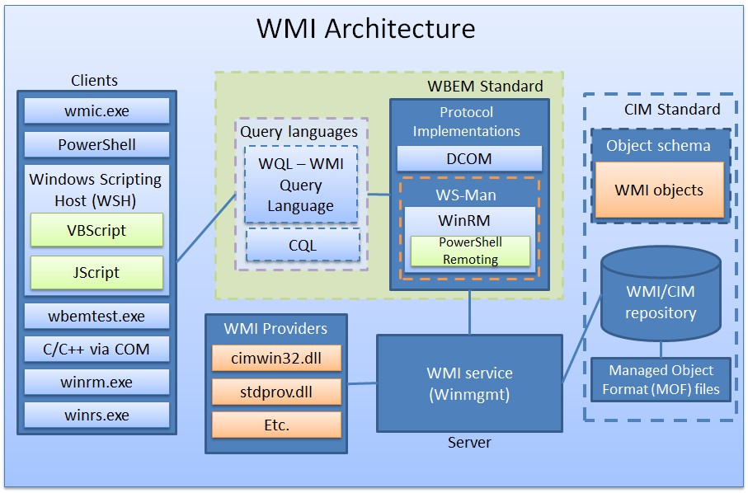
WMI (Windows Management Instrumentation)
Microsoft's implementation of Web-Based Enterprise Management (WBEM) and Common Information Model (CIM) industry standards published by the Distributed Management Task Force (DMTF)
Provides the interface for management data and operations for local or remote computers
Copyright: https://www.blackhat.com/docs/us-15/materials/us-15-Graeber-Abusing-Windows-Management-Instrumentation-WMI-To-Build-A-Persistent%20Asynchronous-And-Fileless-Backdoor-wp.pdf

Slide 16
Win32 API
Set of functions provided by the Windows operating system
Used for resource manipulation
Exposed through various libraries (kernel32.dll, user32.dll, etc.)

Slide 17
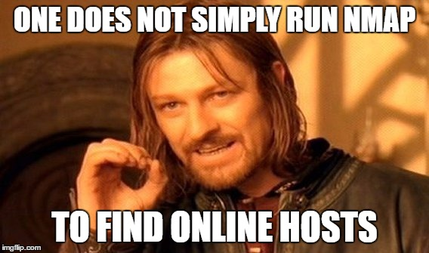

Slide 18
Local IP(s)
Cmdlet
Get-NetIPConfiguration
.NET class
System.Net.NetworkInformation.NetworkInterface
WMI
Win32_NetworkAdapterConfiguration

Slide 19
DEMO

Slide 20
Ping Sweep
Cmdlet
.NET Class
WMI
Test-Connection
System.Net.NetworkInformation.Ping
Win32_PingStatus

Slide 21
DeMO

Slide 22
Port Scanner
.NET Classes
System.Net.Sockets.TcpClient
System.Net.Sockets.UdpClient

Slide 23
DeMO

Slide 24
Active Connections
Cmdlet
.NET Class
WMI
Get-NetTCPConnection
System.Net.NetworkInformation.SystemTcpConnectionInformation
MSFT_NetTCPConnection

Slide 25
DEMO

Slide 26
Reverse DNS
Cmdlet
.NET Class
System.Net.Dns
Resolve-DnsName

Slide 27
DEMO

Slide 28
ARP Scanner
Win32 API
SendARP(iphlapi.dll)

Slide 29
DEMO

Slide 30
Conclusions
Multiple ways to query the local network
Different techniques to obtain the same information
All from non-privilege user

Slide 31
Questions?

Slide 32
Keep in TOUCH
Twitter: @z00v4sh
LinkedIn: https://www.linkedin.com/in/caneacsu/
Email: caneacsu@gmail.com

Slide 33
THANK You !

